Slide 1

EcoMatch AI: An Automated Product Inquiry Response System for Light Recycling Program
Namesh Mathara Arachchi Vidanalage

Slide 2



BACKGROUND & PURPOSE
Product Care Association (PCA)
Recycling post-consumer lighting products across Canada
Manual product inquiry process
Inefficiencies and delays
Inconsistent decision-making
RESEARCH QUESTION
How can I design and implement a product
End-to-end
AI-powered
Integrates text and image data
Minimizes response times
Enhances matching accuracy
NOVELTY
PCA’s first ML-powered system

Slide 3

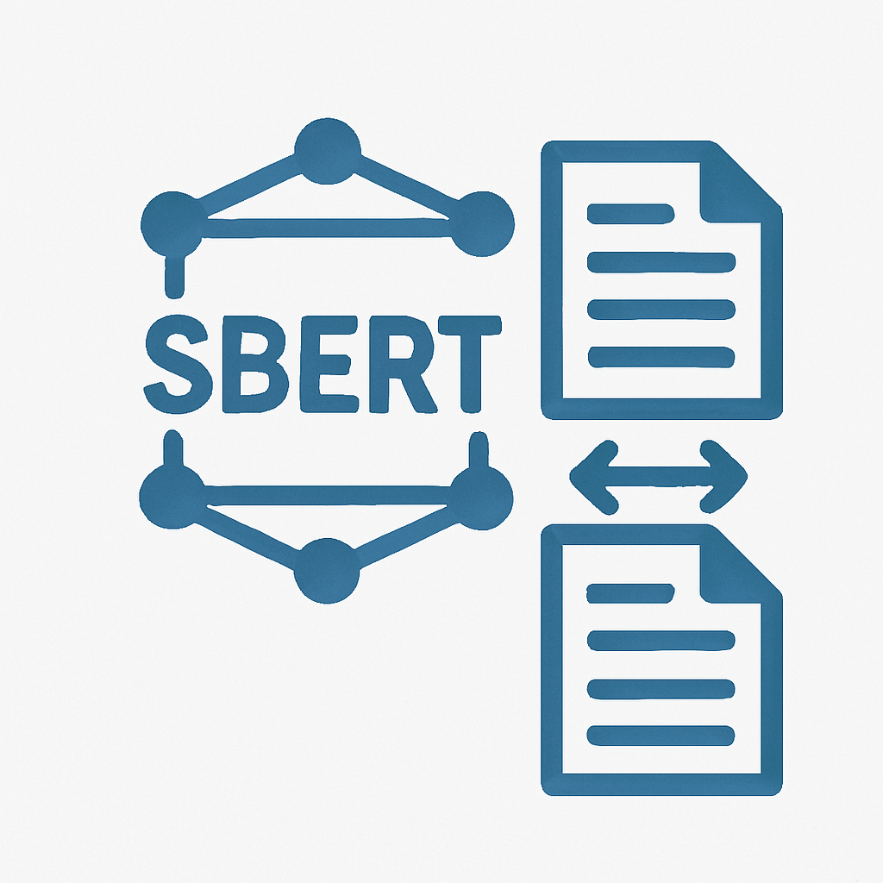

Methodology and Tech Stack
Web Portal
Frontend: Python Flask and Bootstrap
Backend: Python Flask
Data Storage: Azure Table Storage and Azure Blob Storage
Text Similarity
Technique: Sentence-BERT (SBERT) – fine-tuned transformer for semantic similarity
Short text: all-mpnet-base-v2
Long text: bert-large-nli-stsb-mean-tokens
Image Similarity
Technique: Convolutional Neural Networks (CNN) based feature extraction for image similarity
Best performer: ResNet50

Slide 4


Challenges Faced
CNN model - ResNet50 was slow, taking over 5 minutes to run
Limited experience using Python in a full-stack development context
Understanding and applying complex NLP and CNN models
Insufficient labeled data for training ML models
Lessons Learned
Precomputing embeddings drastically cut runtime from 5 minutes to 5 seconds, showing the value of optimizing for production
Persistence and leveraging online resources made it possible to understand complex concepts
Adding an admin review process improved data quality and helped generate valuable training data over time

Slide 5
Thank You!!!

